Slide 1
GenAI Agent for Universal, Dimension Based Data
Quality Scoring in Payments domain
TEAM: Devineni Prem Nag Potluri Lalith Chandh
Anagani Tejus
Kavuru Manoj

Slide 2


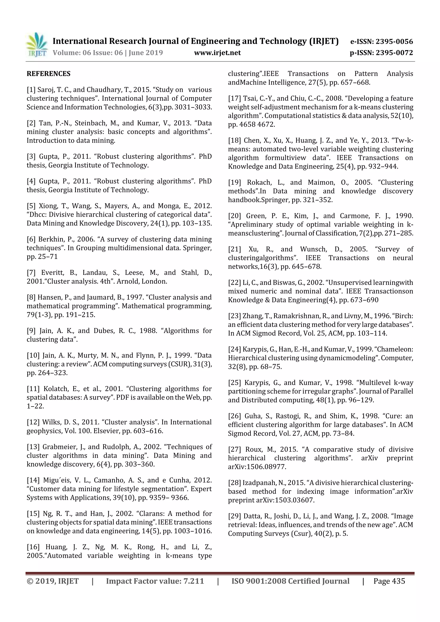

Importance of Transaction Data
Transaction data provides insights into customer behavior and payment trends.
Accurate processing impacts fraud detection and risk management.
Proper handling ensures compliance with regulatory standards.
Notes:
Image source: https://image.slidesharecdn.com

Slide 3
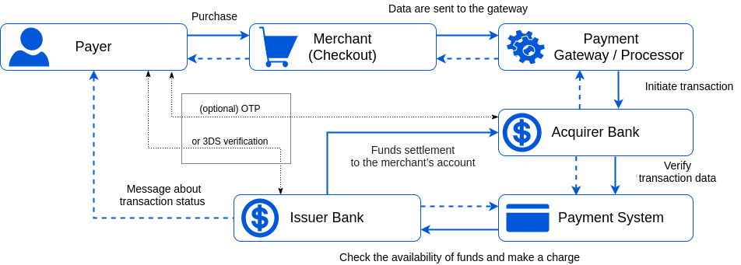
Scope of the Problem
The scale of data generated is growing exponentially.
Legacy systems struggle to manage the increasing data volume efficiently.
There is a need for scalable solutions to process data in real-time.
Notes:
Image source: https://corefy.com

Slide 4
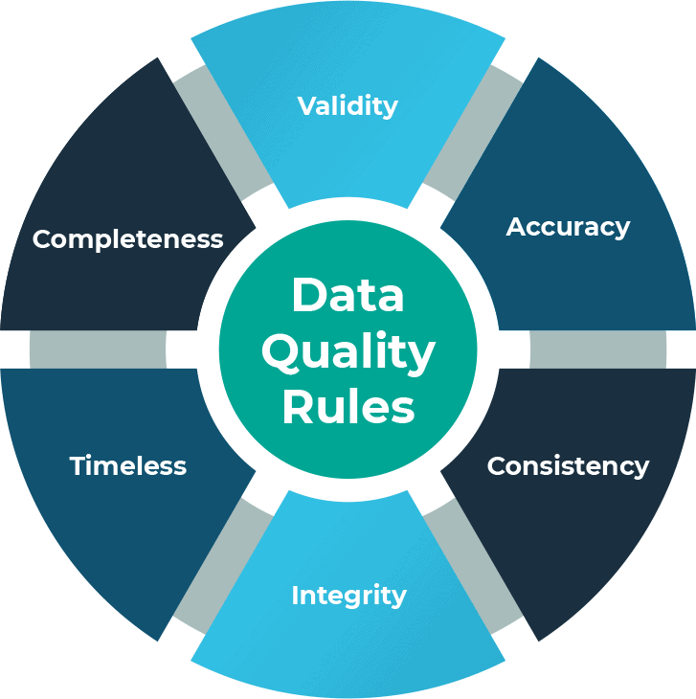
Challenges in Data Processing
High volume and velocity of transaction data lead to processing bottlenecks.
Data quality issues can impair decision-making and fraud detection.
Ensuring data security and privacy is complex with large datasets.
Notes:
Image source: https://thumbs.dreamstime.com

Slide 5

Data Volume Growth
Digital payment methods have accelerated transaction volumes globally.
Mobile payments and contactless transactions contribute to data explosion.
Future growth is expected as digital payments become more prevalent.
Notes:
Image source: https://assets.videomaker.com

Slide 6
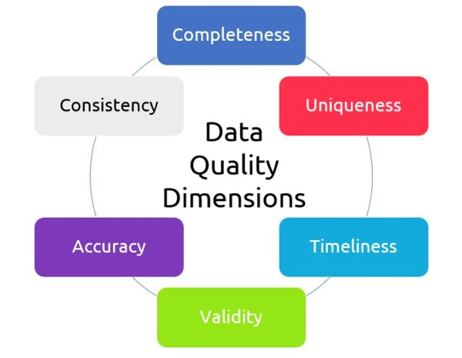
Real-Time Processing Demands
Instantaneous transaction validation is essential for user experience.
Delays in processing can lead to transaction failures and customer dissatisfaction.
Real-time analytics support proactive fraud detection.
Notes:
Image source: https://wallstreetmojocms.recurpro.in

Slide 7
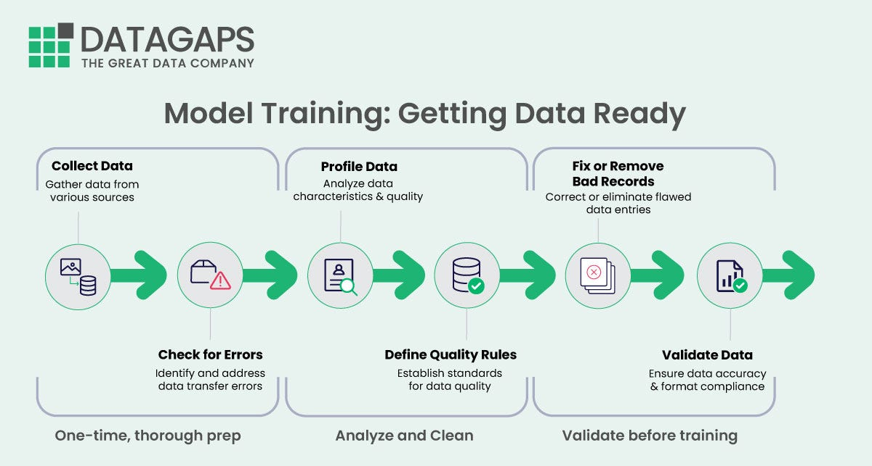
Data Quality and Integrity
Inconsistent or incomplete data can lead to errors in processing.
Data validation mechanisms are necessary to maintain accuracy.
Poor data quality hampers analytics and strategic decision-making.
Notes:
Image source: https://corefy.com

Slide 8

Security and Privacy Concerns
Protecting sensitive payment information is critical to prevent breaches.
Compliance with standards like PCI DSS is mandatory.
Balancing data accessibility and security remains a complex challenge.
Notes:
Image source: https://img.freepik.com

Slide 9
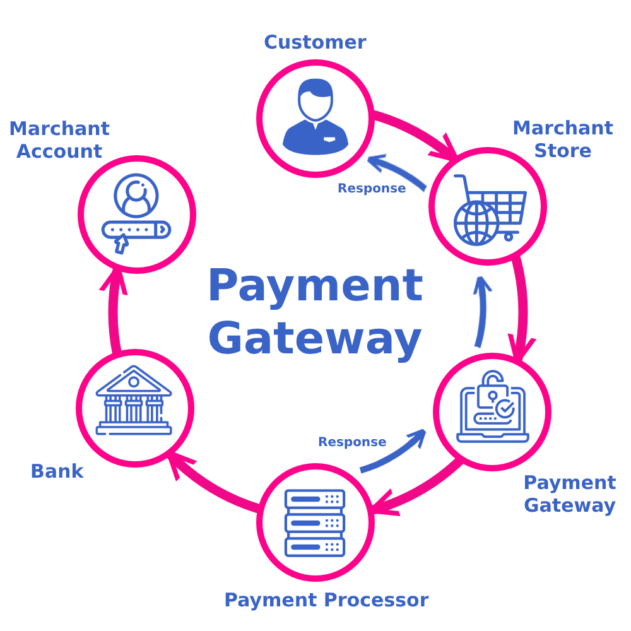
Regulatory and Compliance Issues
Payment organizations must adhere to various international laws.
Data localization and retention policies impact processing strategies.
Non-compliance can result in hefty penalties and reputational damage.
Notes:
Image source: https://thumbs.dreamstime.com

Slide 10
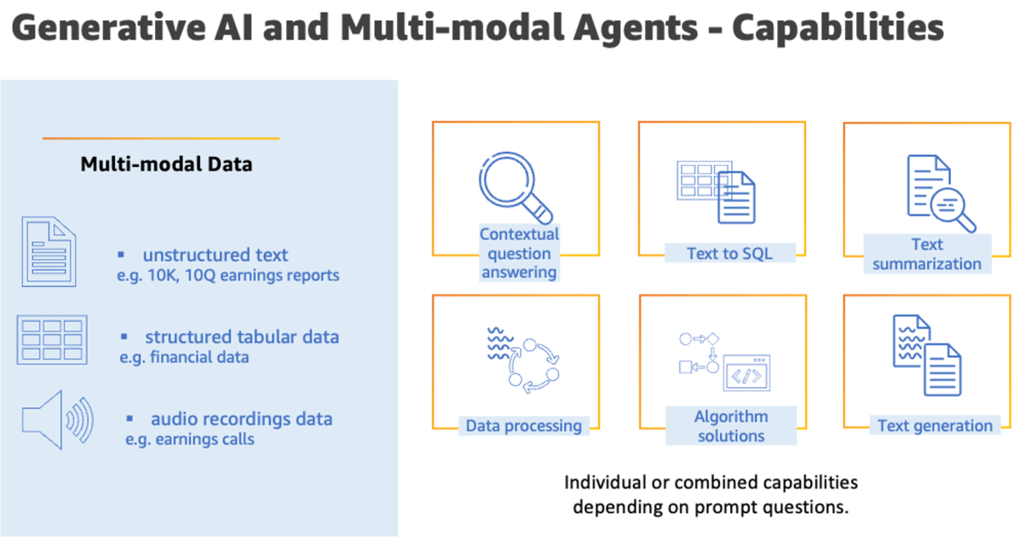
Technological Limitations of Legacy Systems
Older systems lack scalability to handle current data volumes.
They often have slower processing speeds and limited automation.
Upgrading or replacing legacy systems is necessary for future-proofing.
Notes:
Image source: https://thumbs.dreamstime.com

Slide 11
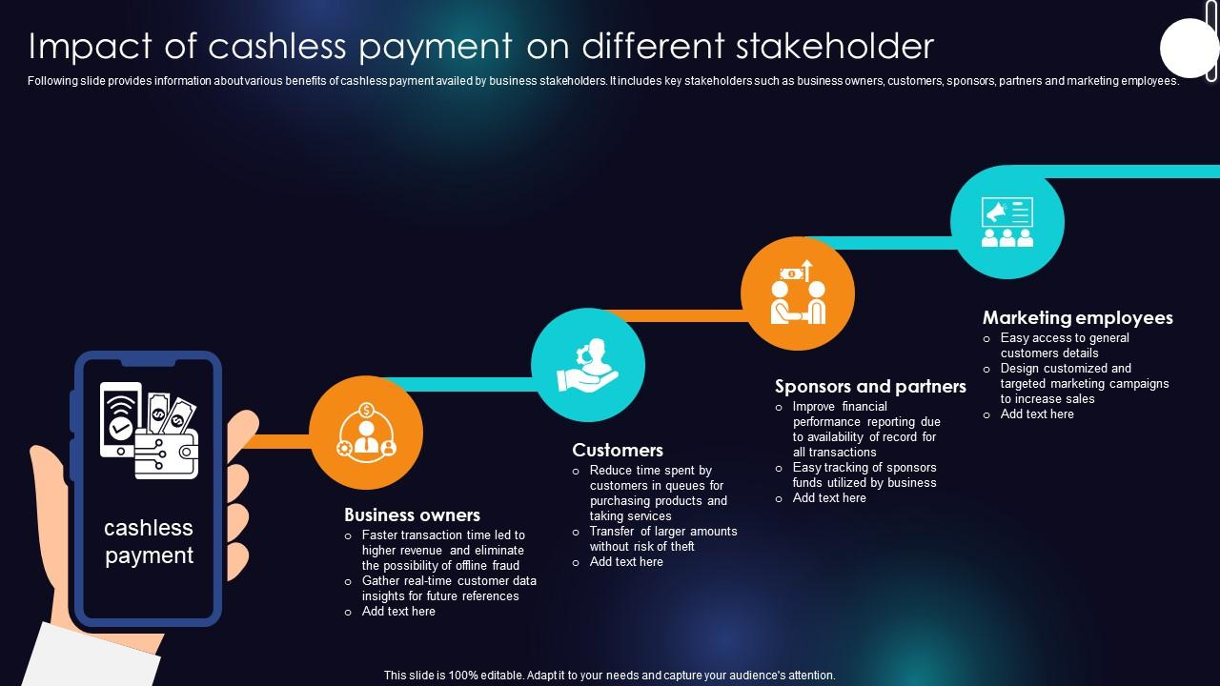
Impact on Customer Experience
Slow or failed transactions diminish customer trust.
Seamless data processing enhances overall service quality.
Efficient data management directly influences customer loyalty.
Notes:
Image source: https://www.slideteam.net

Slide 12

Opportunities for Innovation
Advanced analytics and AI can improve fraud detection accuracy.
Cloud computing offers scalable infrastructure for handling massive data.
Automation reduces manual errors and speeds up processing times.
Notes:
Image source: https://thumbs.dreamstime.com

Slide 13
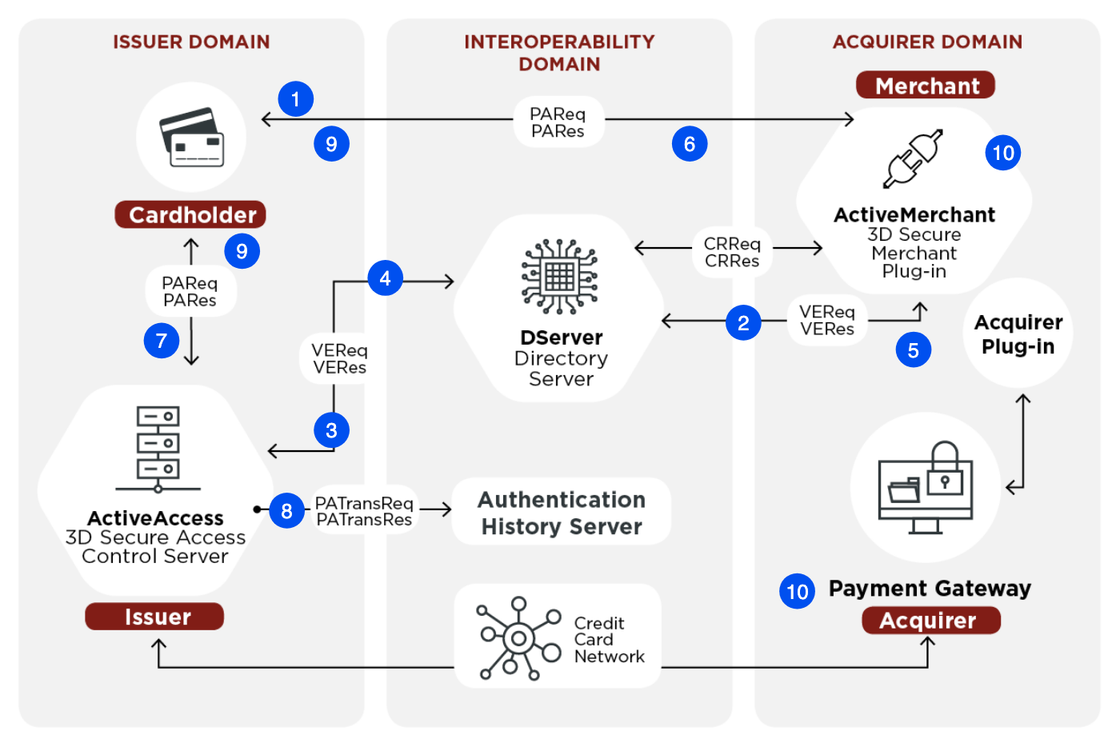
Strategies for Managing Data Volume
Implementing data partitioning and sharding techniques.
Utilizing distributed computing frameworks like Apache Spark.
Employing data compression to optimize storage and transfer.
Notes:
Image source: https://thumbs.dreamstime.com

Slide 14
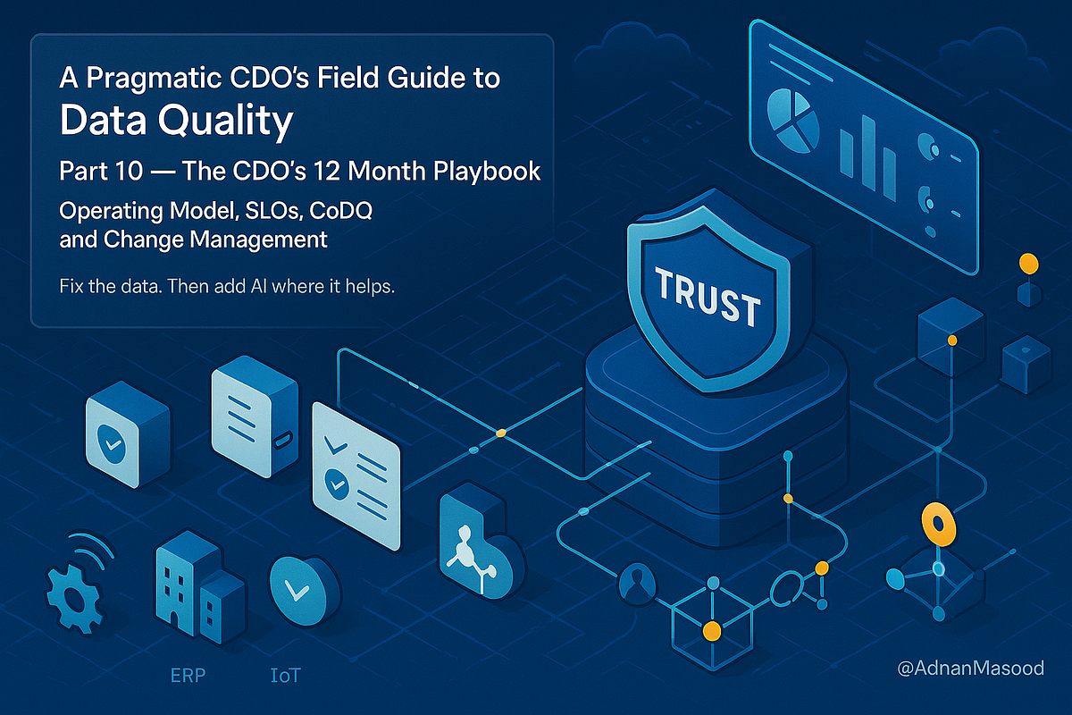
Enhancing Data Security and Privacy
Use of encryption and tokenization to protect sensitive data.
Regular audits and compliance checks strengthen security posture.
User access controls and monitoring prevent unauthorized data access.
Notes:
Image source: https://i1.rgstatic.net

Slide 15
Building a Scalable Data Infrastructure
Transitioning to cloud-based solutions for flexible scalability.
Investing in high-performance databases optimized for transaction processing.
Designing systems for fault tolerance and disaster recovery.
Notes:
Image source: https://corefy.com

Slide 16
Implementing Real-Time Analytics
Leveraging streaming data platforms for immediate insights.
Integrating machine learning models for fraud detection.
Continuous monitoring to adapt to emerging threats and patterns.
Notes:
Image source: https://thumbs.dreamstime.com

Slide 17
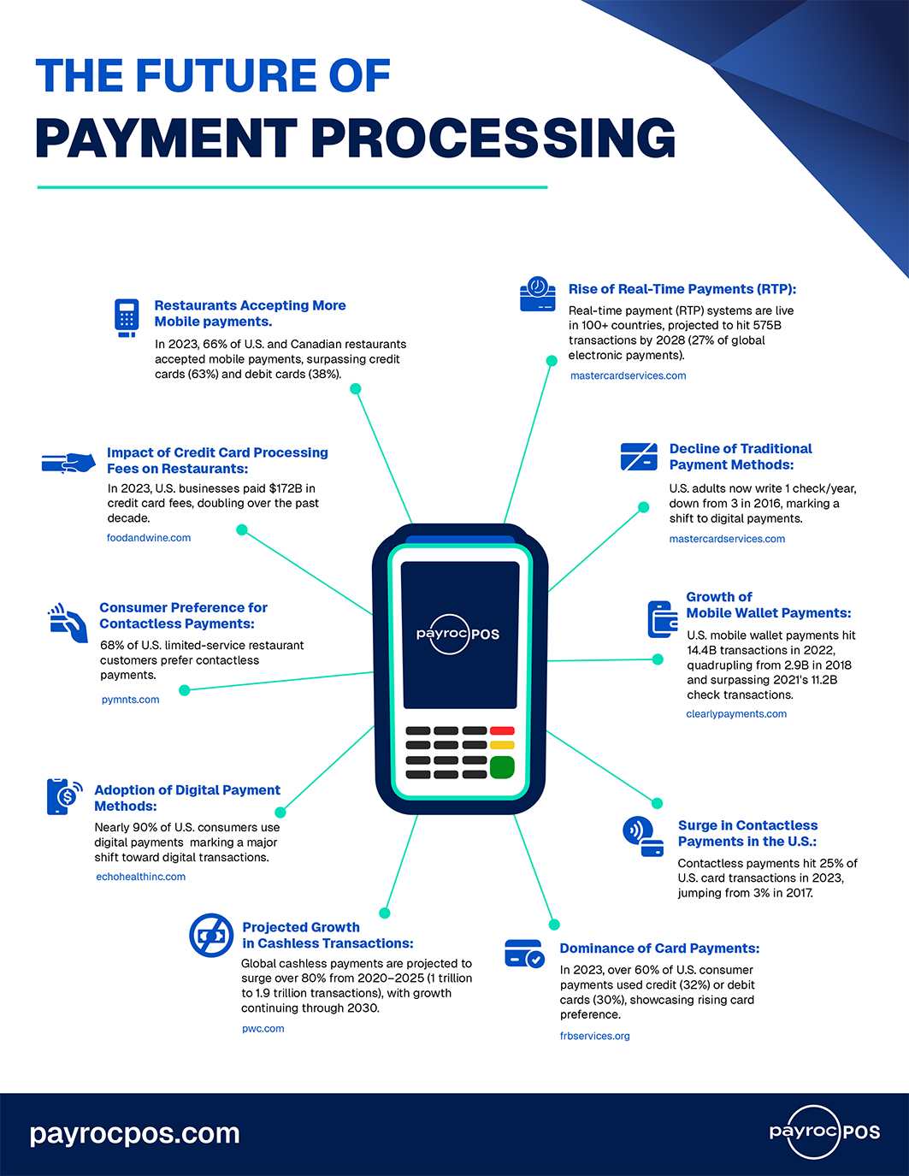
Future Trends in Payment Data Processing
Increased adoption of blockchain for secure transaction records.
Use of AI and machine learning for predictive analytics.
Growing importance of privacy-preserving technologies like federated learning.
Notes:
Image source: https://www.onepos.com

Slide 18
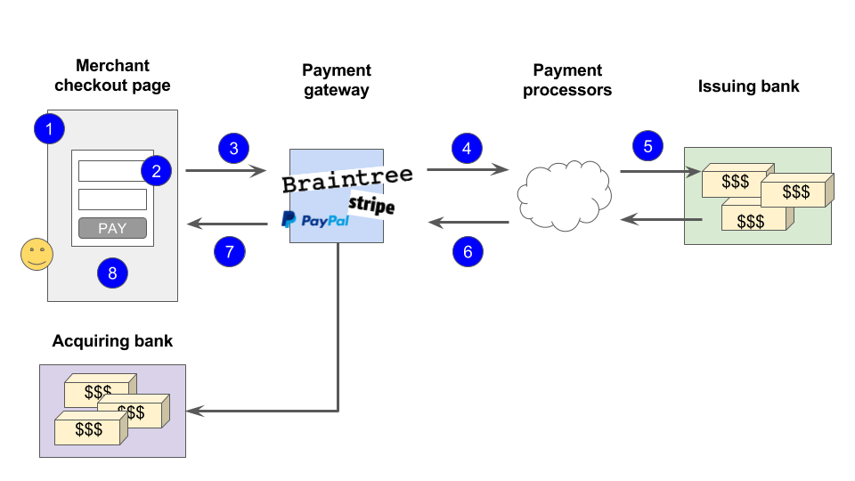
Summary of Key Challenges
Managing the exponential growth of transaction data.
Ensuring data security, privacy, and regulatory compliance.
Upgrading infrastructure to support real-time, scalable processing.
Notes:
Image source: https://thumbs.dreamstime.com

Slide 19
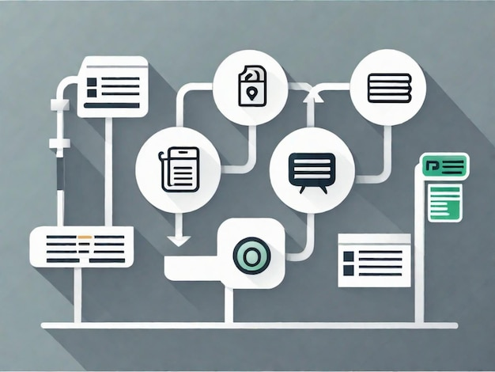
Conclusion and Recommendations
Payment organizations should invest in modern, scalable data systems.
Emphasis on security and compliance is vital for trust and legality.
Leveraging innovative technologies can turn data challenges into strategic advantages.
Notes:
Image source: https://img.freepik.com

